Slide 1

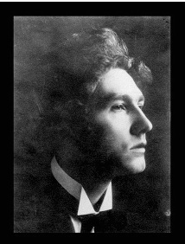
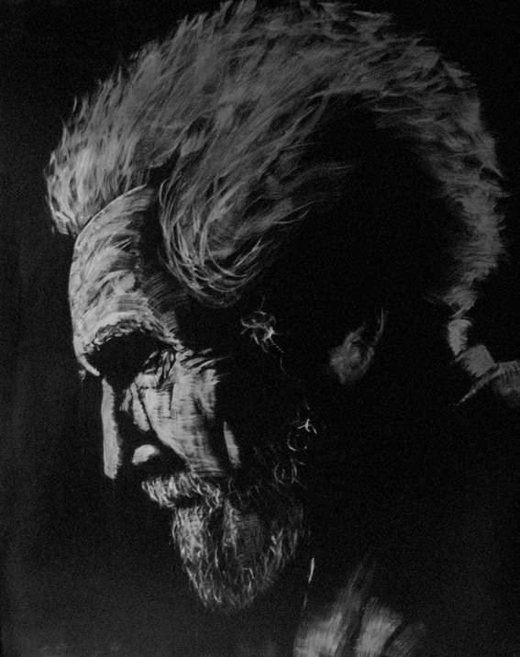
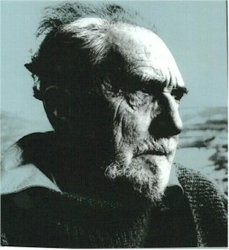
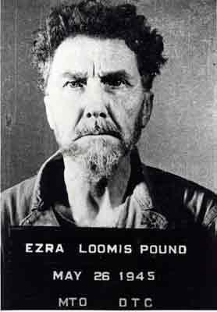
Ezra Pound

Slide 2
Ezra Pound
(1885-1972) American Poet and critic .
In 1920 Pound moved to Paris and Britain.
In Italy, he lived over 20 years, comfortable with his role as an outsider.

Slide 3
Pound’s life..
He was called "the poet's poet" because his profound influence on 20th century writing in English.
Pound believed that poetry is the highest level of arts.
Both Eliot and Pound, knowledge of tradition is necessary for the poet to create "new" poetry.
In the way, their ideas reject Stein's "past-less" writing.

Slide 4
  The principle of the Pound-Eliot philosophy:
1. Traditionalists
2. Impersonalism

Slide 5
Pound’s Style..
Pound's critical Theories have influenced many important American and British poets.
From1909 through the twenties, he was involved in most of the major artistic movements.
The main idea of his theory is that:"literature is language charged with meaning."(ABC of Reading,1934)

Slide 6
Pound’s Style..
He had been a leader of the "Imagist" school of poetry.
He believed that good poetry was based in images rather than ideas.
He also influenced by Asian literature.
The most famous imagist poem is In the Station of the Metro is rather like a Japanese haiku.

Slide 7
Pound’s life..
A rebel par excellence, he challenged many of the common views of his time and spent 12 years in an American mental hospital.

Slide 8
Pound's Works
The Garden (1885-1972)
Portrait D‘une Femme (1885-1972)
In a Station of the Metro
A Girl (1885-1972)

Slide 9

Ezra Pound
In a Station of the Metro
1. The apparition of these faces in the crowd;
2. Petals on a wet, black bough

Slide 10
The introduction of the poem:
It is an Imagist poem by Ezra Pound. The poem attempts to describe Pound's experience upon visiting an underground metro station in Paris in 1912, and Pound suggested that the faces of the individuals in the metro were best put into a poem not with a description but with an "equation".

Slide 11
The poem :
The poem is considered one of the leading poems of the imagist tradition. Written in a Japanese haiku style, Pound’s process of deletion from thirty lines to only fourteen words typifies imagism’s focus on economy of language, precision of imagery and experimenting with non-traditional verse forms.
The heart of the poem is not the first line, nor the second, but the mental process that links the two together.
"In a poem of this sort," as Pound explained, "one is trying to record the precise instant when a thing outward and objective transforms itself, or darts into a thing inward and subjective."
This darting takes place between the first and second lines.

Slide 12
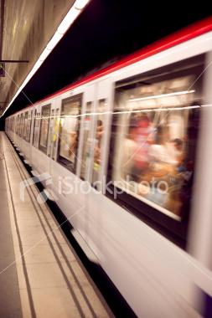
Explanation:
One word that overshadows all the rest in line one is APPARITION. The word "apparition" alone means a ghostly figure, something strange or unusual that suddenly comes into view.
Pound may have seen different faces in a Paris subway and defined the "faces in the crowd" with the illustration of pure beauty or images of flawless human beings.
The reason for formulating such assertion is because of this: with the meaning and usage of the word apparition, it enables Pound to convey the expression of shock and awe once he steps into the metro station.
It's almost as if he discovers the faces in the crowd surprisingly. More importantly, he may have not seen the faces clearly and saw only a blur that he interpreted as a vision of attractiveness.

Slide 13
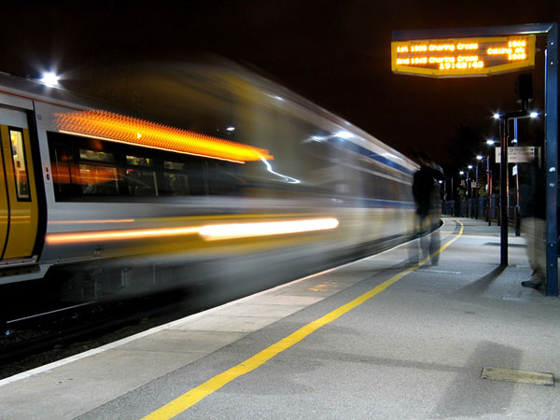

Slide 14

The second line of the poem renders one word that overshadows all the rest: PETALS.
Petals are vibrant flowers that have different colors and represent beauty when blossomed, which he identifies as the "faces in the crowd“. He uses a simile to relate the crowd to petals on a bough. Additionally, petals are flowers that come in various shades, sizes, shapes, and so forth - akin to human beings. Therefore, Pound perhaps envisioned the people in the crowd as beautiful, for the diversity they embodied.
the images are captivating and make the poem move beyond the literal. When one thinks of apparition, the first thing that comes to mind is a ghostly figure. When one thinks of petals, something delightful comes to mind.

Slide 15
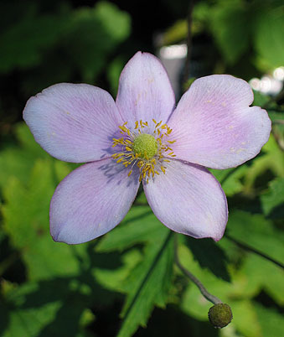

Pound takes the two words and morphs them together as one to get a greater effect, meaning that when he saw mysterious faces in the crowd with various colors and shapes, it was a good-looking sight in his eyes.
The poem shows that whatever color, size, or shape a person is, he or she still has some characteristics of beauty - regardless of their outer appearance.
It said the faces are apparitions because the train is moving. If the train stops, they are not apparitions any longer.
There are a lot of white petals on that black bough. It's a dark night, maybe midnight, and there is no moonlight. When wind blows, some of the petals fly away. The interpretation on the web said that the petals are the faces, pink and sudden. The black bough resembles the long, dark train.
One of the colors of the petals is "white." white means pale. People in the station are tired, weary and exhausted. They could not help but hustle and bustle, and that's why they are pale.

Slide 16

The two contrasting views for
Pro-modernism and
Anti-modernism

Slide 17
Pro-modernism
Pound’s poem can be seen in the eyes of pro-modernity with the help of the word “apparition” in line one, as well as the word “Petals” in the second line of the poem.
The speaker is amazed at all the people in the metro, and this goes to support technological advances in transportation.
The “Petals” can also be used to support pro-modernity as the speaker views each person in the metro as an individual petal of a flower.
Flowers are frequently used as a symbol of beauty, so someone may interpret the speaker comparing the people with petals of a flower in order to show the beauty of nature and how urbanization and industrialization are advancing nature’s beauty.

Slide 18
Anti-modernism
On the contrary, one may also see an anti-modernity theme in “In a Station of the Metro.”
The “apparition,” or ghostly figures can be interpreted as an evil sighting, with the ghosts being full of malicious intent. Ghosts are seldom seen as beautiful, and one may believe the speaker mentions these beings in order to bring about thoughts of how urbanization leads to the destruction of nature.
The fact that the petals are black results in feelings of death and wickedness. The movement of urbanization and industrialization may be leading to the deaths of all the people in the crowd at the metro.
The adjective “wet,” in line two also makes one perceive a feeling of a gloomy, rainy day at the metro, casting a pessimistic outlook on the modernism movement.

Slide 19

Pink Emerald
Abrar Al-Harthi
Basma Sawadi
Rana Al-Ghamdi
Rogaiah Al-Yaba
Samar Sulimani

